Slide 1
Use Case Diagrams
Dmitriy Sinitsyn

Slide 2
Use case diagrams represent a graphical overview of the functionality provided by the system in terms of actors, their goals, and dependencies between them.

Slide 3
Why create a use case?
A great way to show how the functionality works
To represent how the system responds to the end user interactions by illustrating the interaction between the end user and the system from the user’s perspective
Very easy to understand by non-technical stakeholders

Slide 4
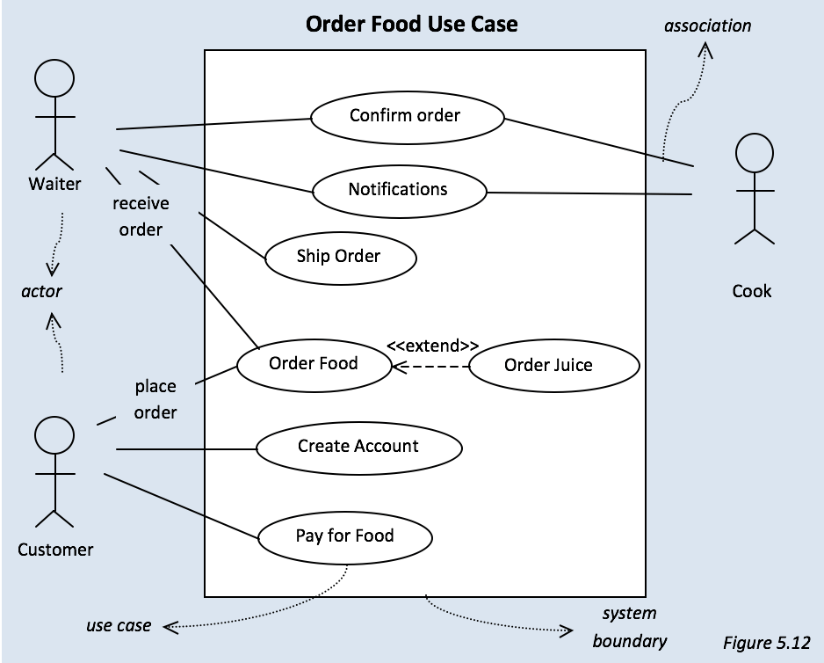

Slide 5
In the above example, you can see some actors and functions (use cases) connected by a bunch of relationships (associations) to define the interactions between them. Before we get into the use case components, let's understand the system described in the above example:
The system will be used by three types of actors: Waiters, Customers and a Cook
Customers will place their order. Customers can also order a drink
Customers will enter their information and pay for food
Waiters will recieve the order and send it to the Cook
The Cook will prepare the food and send a notification to the Waiter
Waiters will finalize the order and deliver it to the Customer's address

